Slide 1

C Programming
Tutorial 2

Slide 2
What we are going to cover
Code Commenting
Reading User Inputs
Format Specifiers
Variables

Slide 3

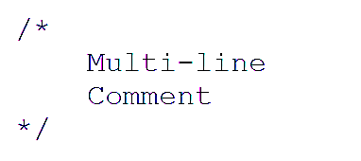
How do you write comments in a c program? What is the purpose of comments in a program?
Syntax

Slide 4
How do you write comments in a c program? What is the purpose of comments in a program?
More Human Readable Code
Saves Time

Slide 5
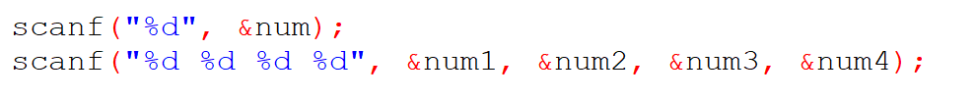
What is the purpose of ‘scanf’ ?
Syntax scanf(“Format_Specifier”, &Variable);
Examples

Slide 6
%c Character
%d Signed integer
%f Float values
%i Unsigned integer
%l %ld %li Long
%lf Double
%Lf Long double
%o Octal representation
%p Pointer
%s String
%u Unsigned int
%n Prints nothing
Some Useful Format Specifiers

Slide 7


Determine which of the following are valid identifiers. If invalid, explain why.
(a) record1 (e) $tax (h) name-and-address
(b) 1record (f) name (i) name_and_address
(c) file-3 (g) name and address (j) 123 - 45 - 6789
(d) return

Slide 8

Questions

